Slide 1

The Magic and Science of Teams
Is there a Science of Teams?

Slide 2
Stop Stumbling on Your Way to High Performance Teams

Slide 3
“People Working on the Same Product but not Collaborating are Essentially Working Separate Tandem Products”
–Ben Waber, People Analytics

Slide 4
Myths or Facts
Scrum is a tool for creating high performance teams
Video Conference Tools are as good as face to face
Coffee Breaks
Face to Face Communication Matters
Put People in Room and You get a Team
Social Talk
Constraints harm Teams
Teams Need Saving from Cowboy’s

Slide 5

Benefits
Understand why Coffee Breaks are important
Teams form faster
Comm
Patterns
Cohesion
You will lose less hair

Slide 6
Background
10 min
6 Rounds
10-15 min
Wrapup

Slide 7
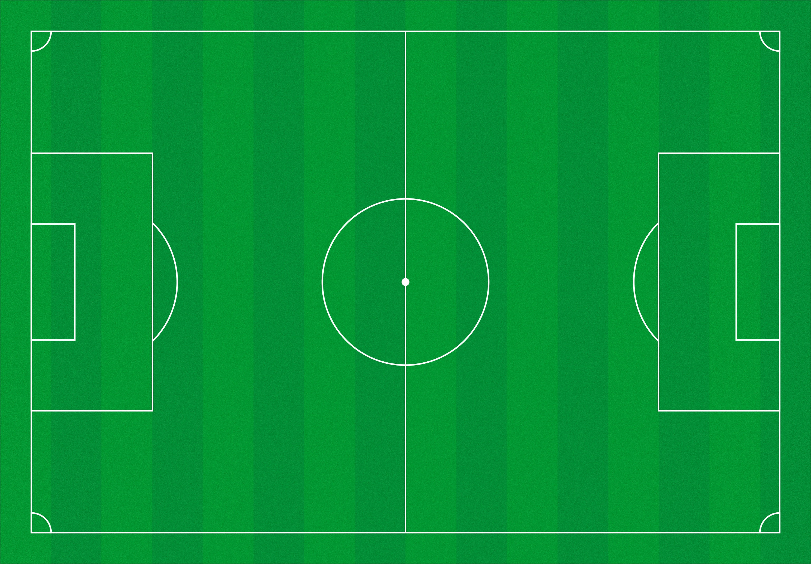

Slide 8
Background

Slide 9
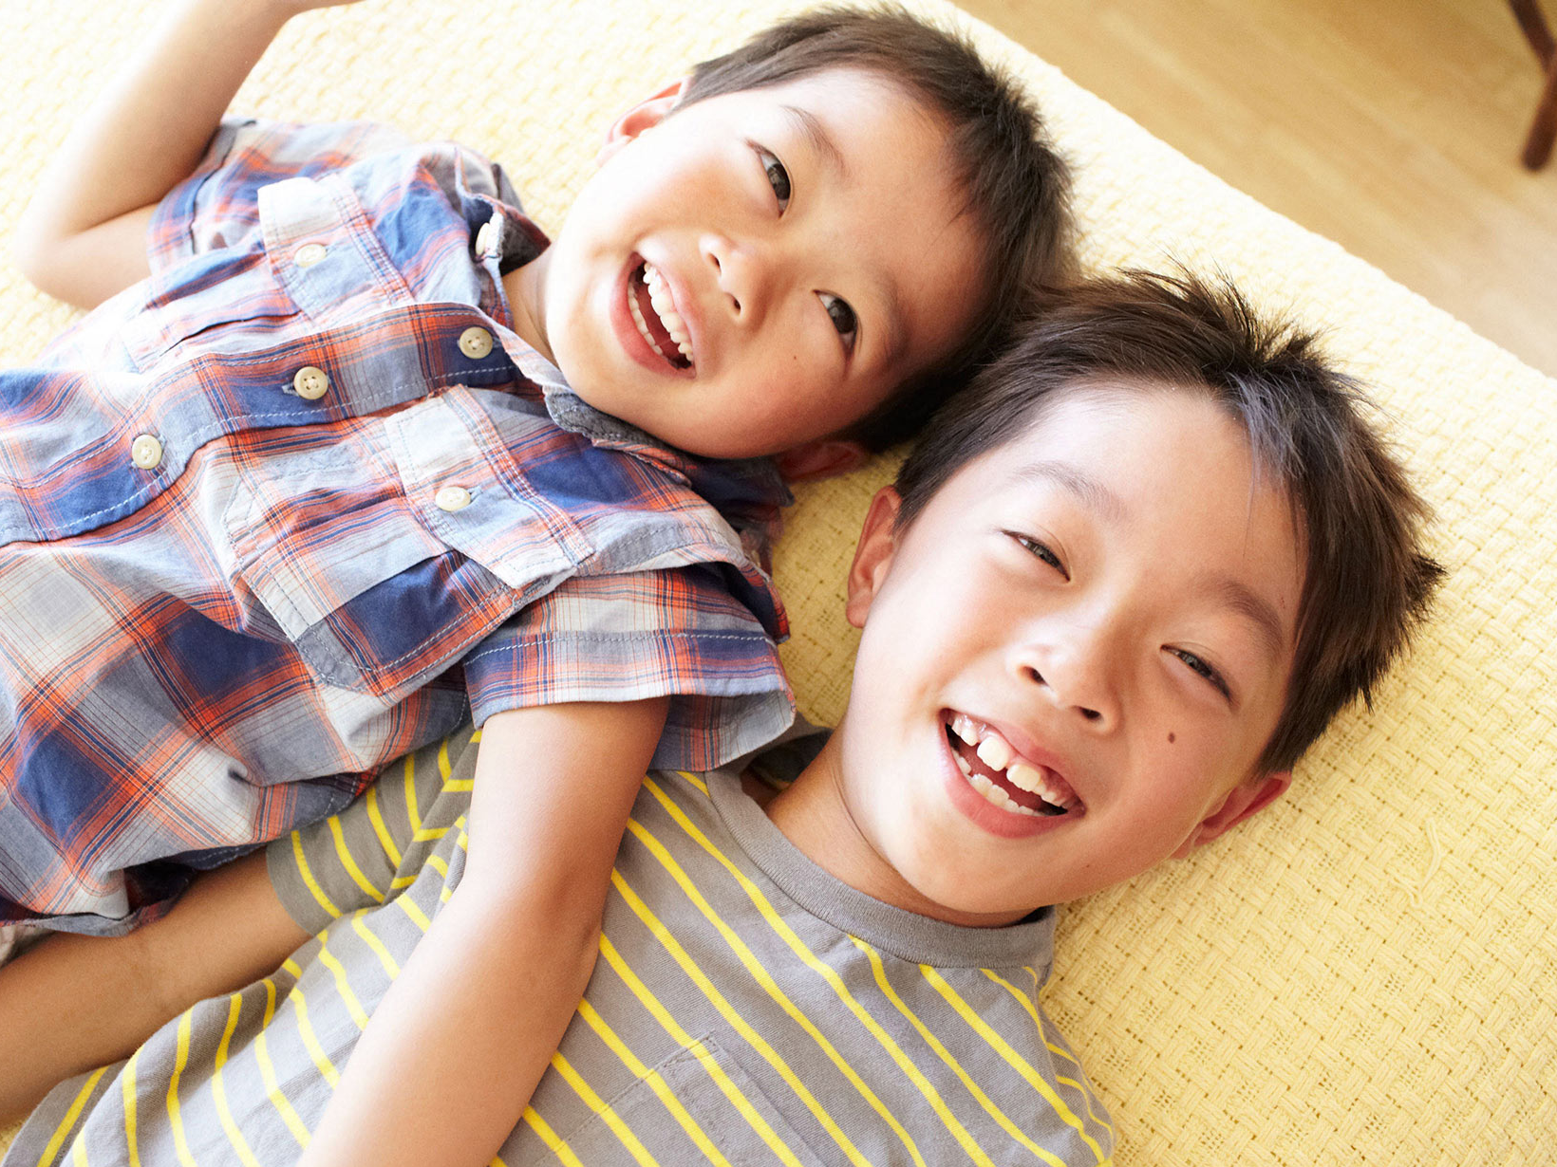


Slide 11
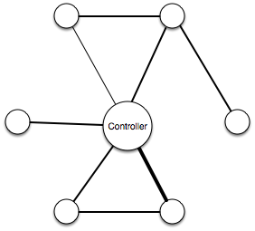
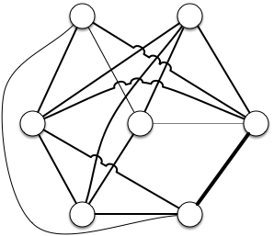
Cohesive Networks
VS.

Slide 12
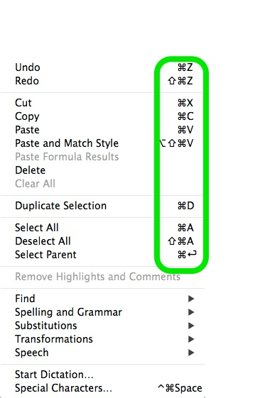
Shared Language
Notes:
…and Shortcuts are part of what enables a cohesive team to get work done more quickly.

Slide 13
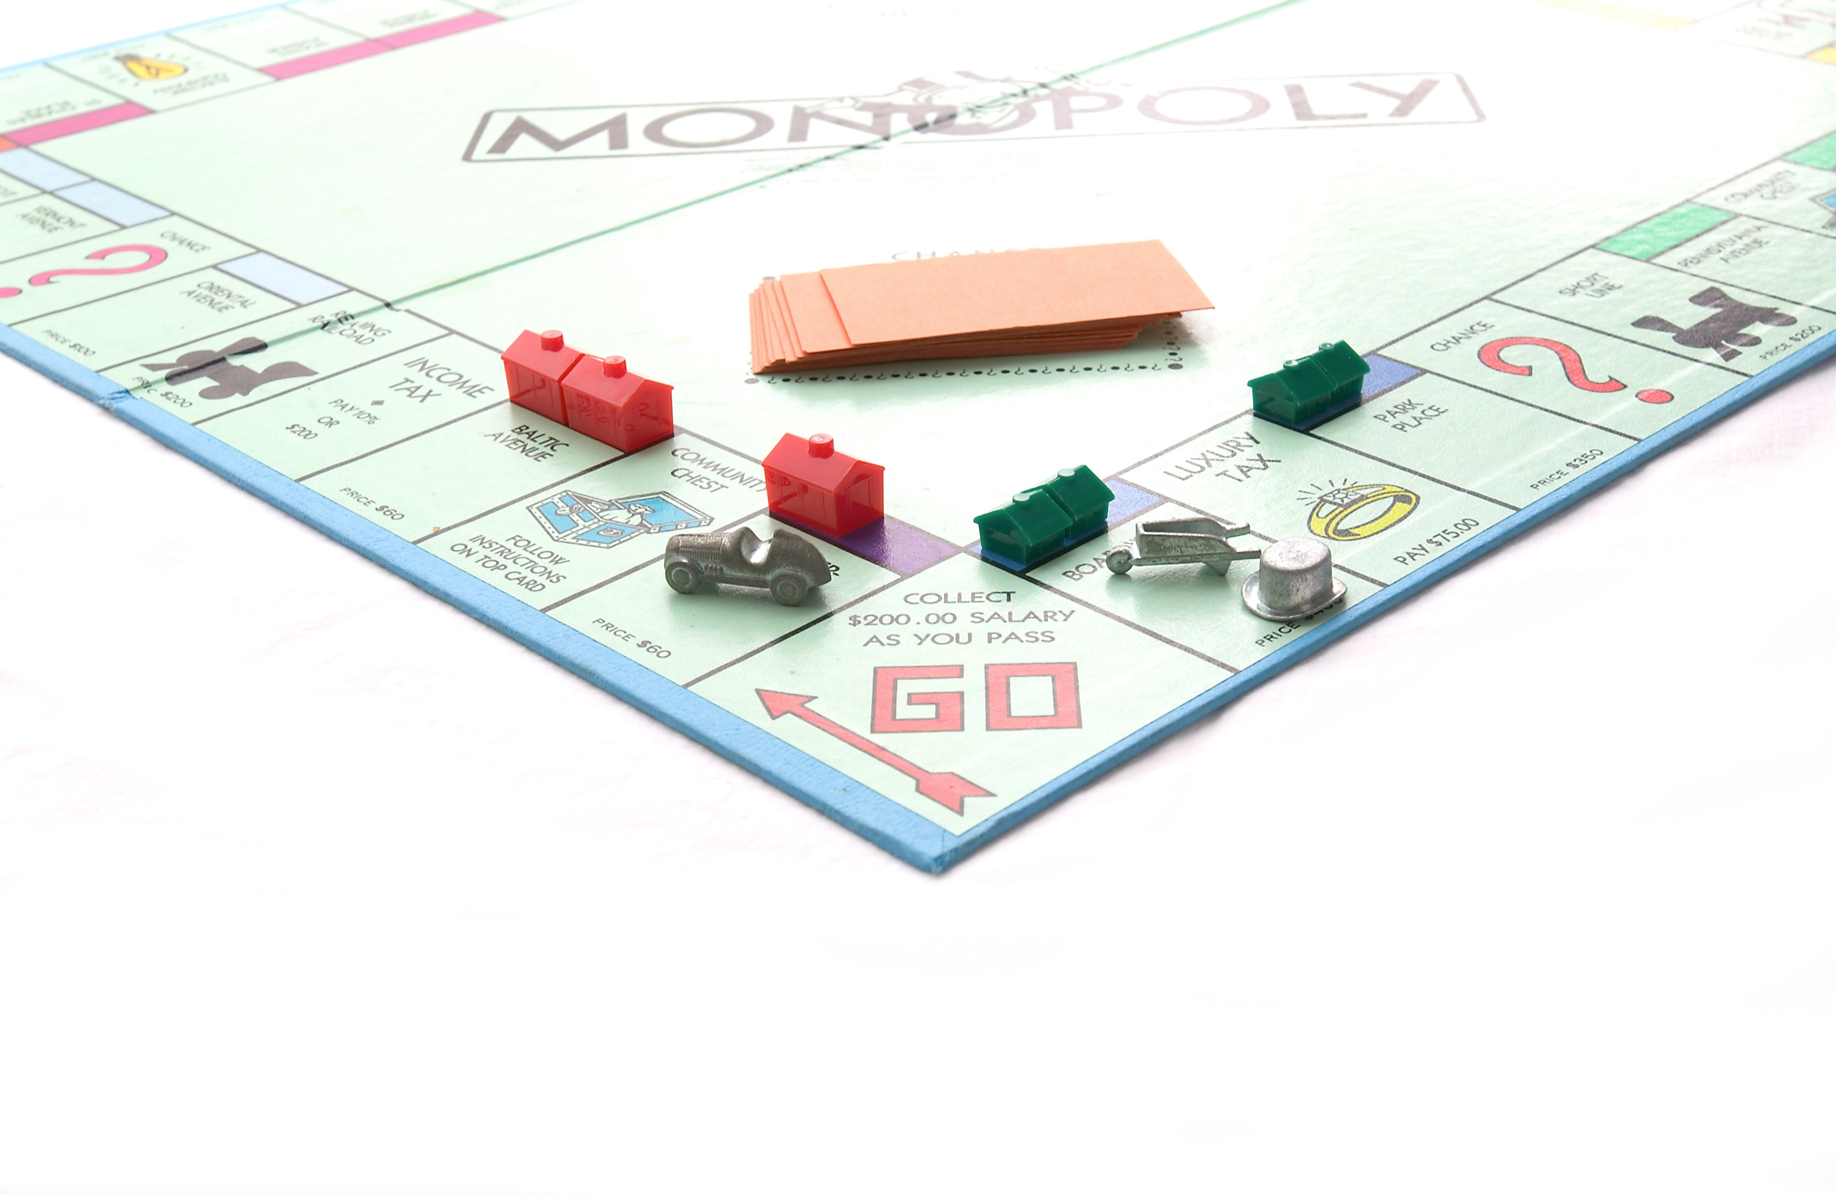

Slide 14
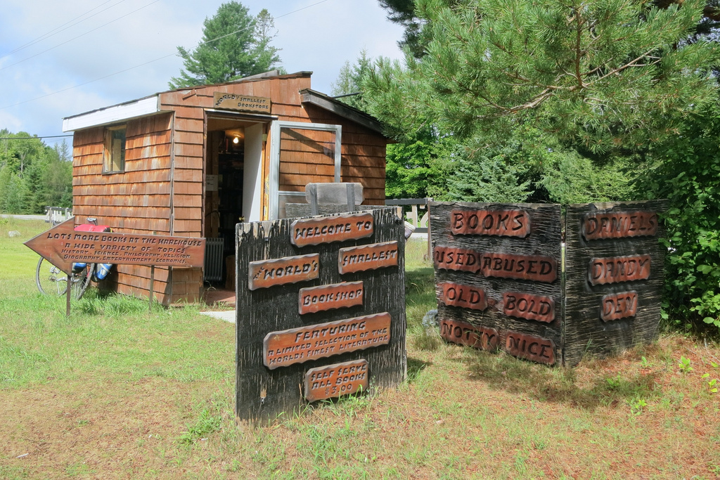
Smallest Online Bookstore

Slide 15
Game Structure
Decide and Commit to actions - 5 mins
Science
Results for Actions Revealed
Roll Dice for Stories -> Determine number complete
Roll 2 Dice for Gremlins
Calculate capacity for next round

Slide 16
Capacity
Initial Capacity -10
Your boss wants you to buy stories, stories, stories. His favourite quote - “Work Harder not Smarter”

Slide 17

Decide

Slide 18

Decide

Slide 19
Notes:
Many of our behaviours evolved pre-language and still need to be supported today. We evolved with face to face communication and participating in small groups. Bonobo’s forage in groups of 6-7 for several days foraging.

Slide 20

Notes:
Story about a German bank where the communication among team members was almost entirely over email. Their goal was to a launch a new product and the results were considered disastrous.
Video discussions are count to some degree but not anywhere near as much

Slide 21

Qualities
~35%
1 on 1
Whole Group
Notes:
35% of variation in team performance account for by number of face to face exchanges.
1 on 1 or very small group - in depth
Whole Group - brief to the point statements
Rough balance between whole group and one-on-one

Slide 22
Distributed

Slide 23

Results for Actions

Slide 24

Dice Roll for Stories

Slide 25

Dice Roll for Gremlins

Slide 26

Calculate Revised Capacity

Slide 27
Decide

Slide 28
Decide

Slide 29
Water Coolers Matter!

Slide 30


Notes:
Neither formal corporate meetings nor chatting at desks increased cohesion

Slide 31

Notes:
Instead it was overlapping break time and lunches.

Slide 32
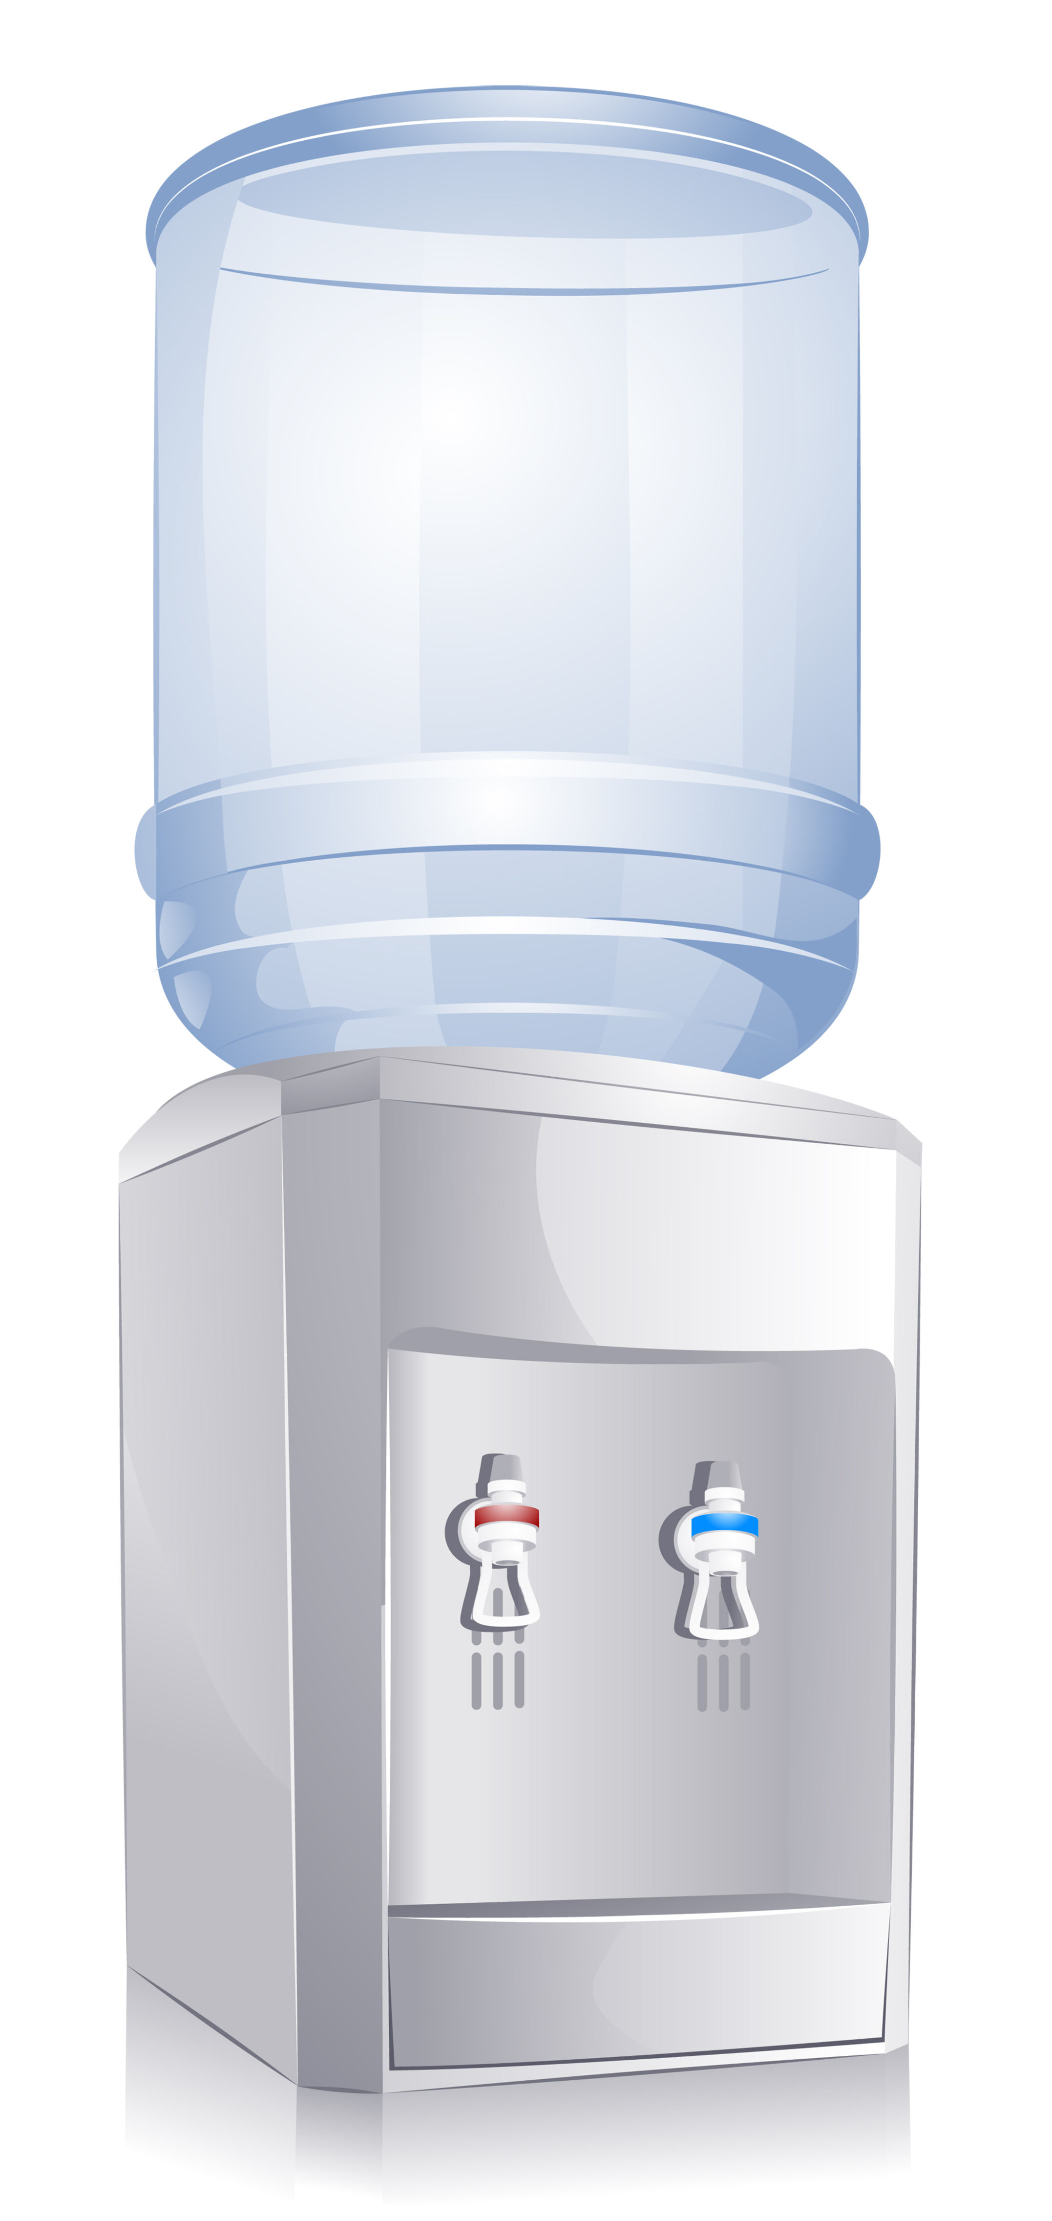
Notes:
What matters - having a water cooler/common coffee place. Having common breaks. Finally a longer lunch table. The longer lunch table helps because it makes it possible for a team to sit together and for a couple of outsiders to join them.

Slide 33
Social Time
Notes:
Social time accounts for more than 50% of positive changes in communication patterns. Conversations happened on breaks at water cooler, coffee machine and in the lunch space. Back to those long lunch tables. Sadly beer at the pub and formal organized offsite events had limited effect.
Many of the conversations were not about work. Non work conversations helped to build trust. Sadly some organizations discourage conversations outside of work.

Slide 34

Why does this matter?
Notes:
High performance teams are built and maintained on the quality of the relationships among the team members

Slide 35
Results for Actions

Slide 36
Dice Roll for Stories

Slide 37
Dice Roll for Gremlins

Slide 38
Calculate Revised Capacity

Slide 39
Decide

Slide 40
Decide

Slide 41

Ineffective Goals

Slide 42

Meaningful Goals

Slide 43
Team Working Agreements
Definition
of
Done
All Perspectives are good
Daily Scrum
Time
Team Lunch Day
Headphones off time
Diverse Opinions Welcomed
Notes:
Scrum Teams need to establish working agreements - what can you establish to support that will help support cohesion

Slide 44
Results for Actions

Slide 45
Dice Roll for Stories

Slide 46
Dice Roll for Gremlins

Slide 47
Calculate Revised Capacity

Slide 48
Decide

Slide 49
Decide

Slide 50

Coach The Team
Notes:
…not the individuals

Slide 51


Observe Behaviours
Notes:
Do they face others during meetings or do they make an effort to hide physically?
Do they speak loudly and clearly enough to be heard and understood by their peers?
Is someone else on the Team dominant at the expense of others?
Are the people who are isolated attempting to contribute and being ignored?
Do they cutoff others and therefore discourage others from listening to them?
Do they talk to only one other Team member?
Is there a flow, or give and take, when they’re involved in the conversation?

Slide 52
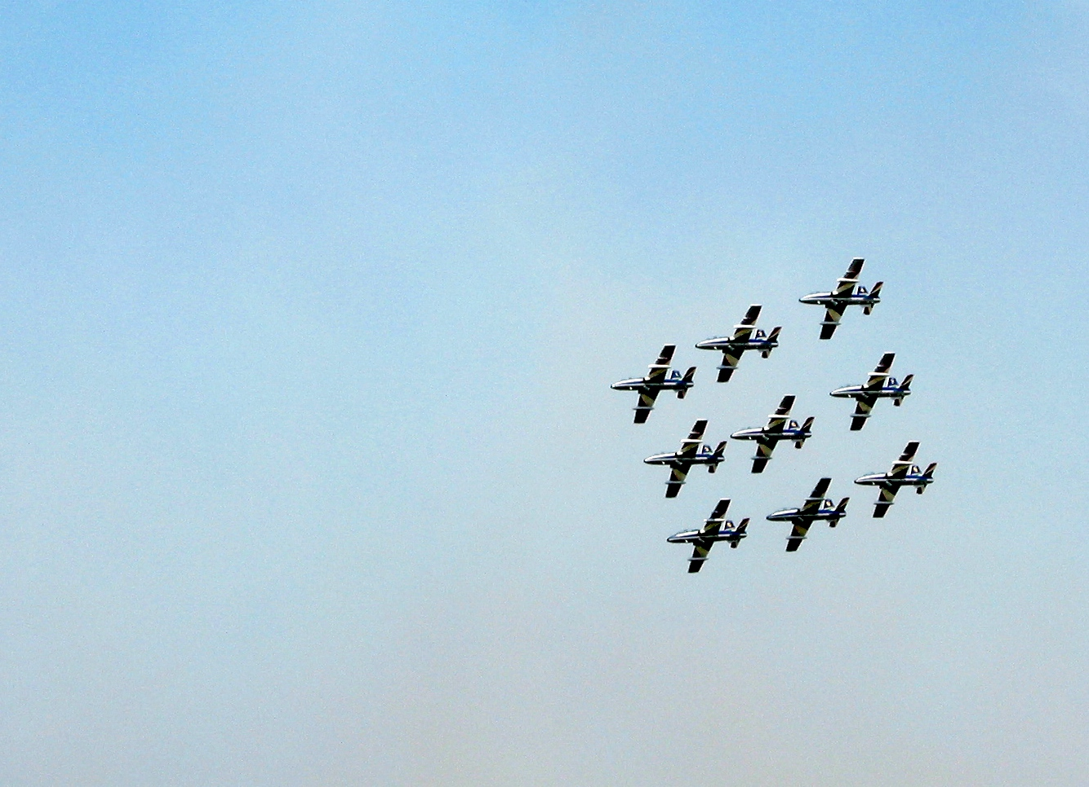
Team Behaviours

Slide 53
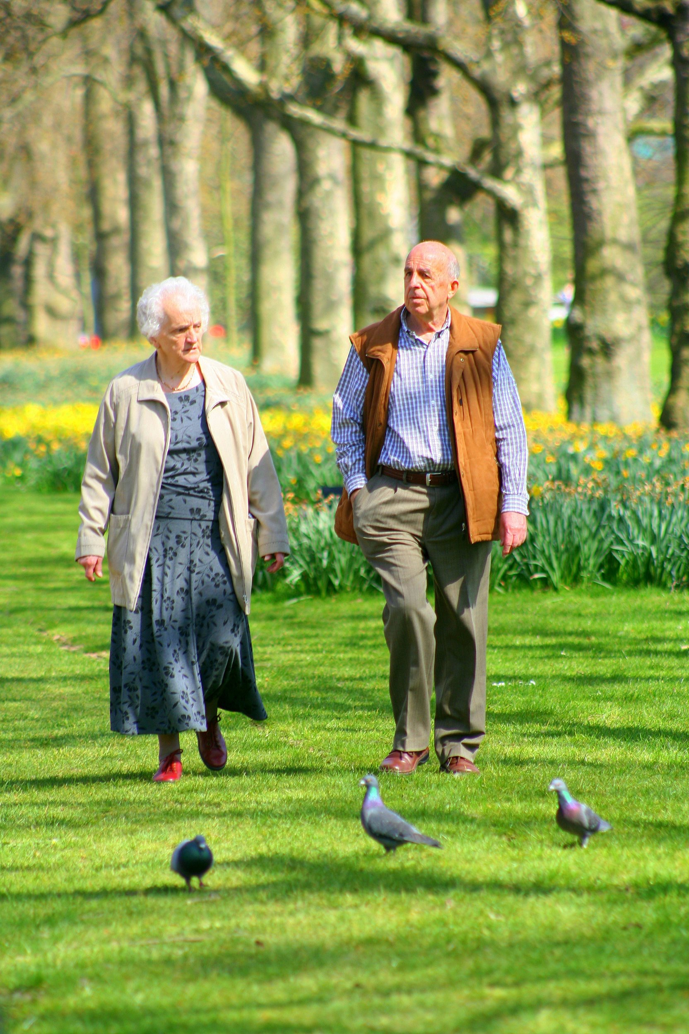
One on One

Slide 54
Tactics
Model
Feedback
Social Opportunities
Seating
Change Membership?

Slide 55
Results for Actions

Slide 56
Dice Roll for Stories

Slide 57
Dice Roll for Gremlins

Slide 58
Calculate Revised Capacity

Slide 59
Decide

Slide 60
Decide

Slide 61
Results for Actions

Slide 62
Dice Roll for Stories

Slide 63
Dice Roll for Gremlins

Slide 64
Calculate Revised Capacity

Slide 65
Deep Conversation
Notes:
Requires a common background and common language
Clearly this is part of the startup cost for new teams and also the cost of changing team membership

Slide 66
References
“People Analytics” - Ben Waber
“The New Science of Building Great Teams” - Alex “Sandy” Pentland
“The Wisdom of Teams” - Jon R. Katzenbach and Douglas K. Smith
“Leading Teams” - Richard Hackmann
“The Wisdom of Teams” - James Surowiecki

